Slide 1
DTS207TC Database Development and Design
Lecture 11
Chap 17. Transactions
Di Zhang, Autumn 2025
Notes:
I am very happy to have the opportunity to meet with you all in this course.

Slide 2
Outline
Review of OS&Parallel Computing
Transaction Concept
Serializability
Recoverability
Implementation of Isolation
Transaction Definition in SQL

Slide 3
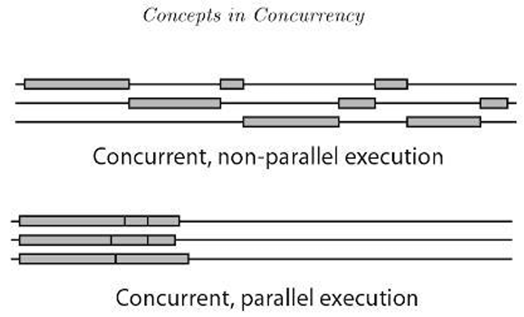
Concurrency vs. Parallelism
Parallel Computing Perspective
  Multiple cores execute tasks simultaneously
  Goal: Speedup through parallel execution
Operating System Perspective
  Process/thread scheduling
  Time-sharing creates the illusion of concurrent execution
Database Connection
  A database handles multiple transaction requests at once
  This is also a form of concurrency and possibly parallelism

Slide 4
The Core Problem: Synchronization & Race Conditions
Critical Section: A shared resource (printer, variable, file) that cannot be safely used by multiple threads at once.
Race Condition: The outcome depends on the non-deterministic sequence of operations.
Database Analogy:
  The shared resource is a bank account balance.
  Two concurrent transactions both read the balance, calculate a new one, and write it back.
  Result: One transaction's update is lost!

Slide 5
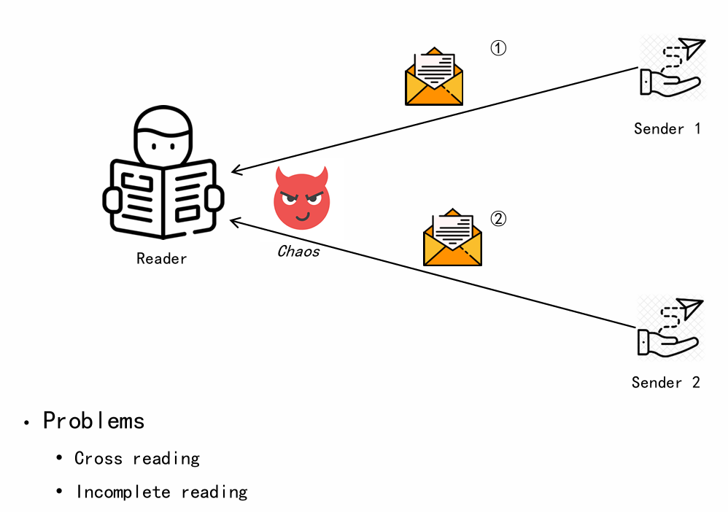
OS Solutions: Mutual Exclusion & Locks
Mutual Exclusion (Mutex): Ensures only one thread executes a critical section at a time.
Semaphores: A generalized counter for controlling access to a pool of N identical resources.
These are the fundamental tools for preventing race conditions in OS and parallel programming.
Database Preview:
  Databases face the exact same problem with data items (rows, pages, tables).
  They need their own version of locks and protocols. This is called Concurrency Control.

Slide 6
The Bridge: From OS Concepts to Database Transactions
OS / Parallel Concept | Database Concept
Process / Thread | Transaction
Critical Section | Data Item (e.g., row)
Race Condition | Read-Write Conflict
Mutex / Lock | Data Lock
Synchronization Protocol | Concurrency Control
In fact, database transactions are implemented using OS critical sections at the underlying level.
  Hardware provides atomic instructions (such as CMPXCHG) -> The operating system uses them to implement low-level primitives (such as spinlocks) -> The operating system provides synchronization APIs to user space based on these low-level primitives (such as mutexes pthread_mutex, semaphores).
You already understand the problem (race conditions) and the goal (correctness). In this lecture, we will learn the specific solutions and guarantees that databases provide. These guarantees are summarized by the ACID properties:
  Atomicity, Consistency, Isolation, Durability.
  We are now ready to dive into the world of database transactions!

Slide 7
Transaction Concept
A transaction is a unit of program execution that accesses and possibly updates various data items.
E.g., transaction to transfer $50 from account A to account B:
  1. read(A)
  2. A := A – 50
  3. write(A)
  4. read(B)
  5. B := B + 50
  6. write(B)
Two main issues to deal with:
  Failures of various kinds, such as hardware failures and system crashes
  Concurrent execution of multiple transactions

Slide 8
Example of Fund Transfer
Transaction to transfer $50 from account A to account B:
  1. read(A)
  2. A := A – 50
  3. write(A)
  4. read(B)
  5. B := B + 50
  6. write(B)
Atomicity requirement
  If the transaction fails after step 3 and before step 6, money will be “lost” leading to an inconsistent database state
    Failure could be due to software or hardware
  The system should ensure that updates of a partially executed transaction are not reflected in the database
Durability requirement — once the user has been notified that the transaction has completed (i.e., the transfer of the $50 has taken place), the updates to the database by the transaction must persist even if there are software or hardware failures.

Slide 9
Example of Fund Transfer (Cont.)
Consistency requirement in above example:
  The sum of A and B is unchanged by the execution of the transaction
In general, consistency requirements include
  Explicitly specified integrity constraints such as primary keys and foreign keys
  Implicit integrity constraints
    e.g., sum of balances of all accounts, minus sum of loan amounts must equal value of cash-in-hand
  A transaction must see a consistent database.
  During transaction execution the database may be temporarily inconsistent.
  When the transaction completes successfully the database must be consistent
    Erroneous transaction logic can lead to inconsistency

Slide 10
Example of Fund Transfer (Cont.)
Isolation requirement — if between steps 3 and 6, another transaction T2 is allowed to access the partially updated database, it will see an inconsistent database (the sum A + B will be less than it should be).
T1 T2
  1. read(A)
  2. A := A – 50
  3. write(A)
  read(A), read(B), print(A+B)
  4. read(B)
  5. B := B + 50
  6. write(B
Isolation can be ensured trivially by running transactions serially
  That is, one after the other.
However, executing multiple transactions concurrently has significant benefits, as we will see later.

Slide 11
ACID Properties
To preserve the integrity of data the database system must ensure:
Atomicity. Either all operations of the transaction are properly reflected in the database or none are.
Consistency. Execution of a transaction in isolation preserves the consistency of the database.
Isolation. Although multiple transactions may execute concurrently, each transaction must be unaware of other concurrently executing transactions. Intermediate transaction results must be hidden from other concurrently executed transactions.
  That is, for every pair of transactions T_{i} and T_{j}, it appears to T_{i} that either T_{j}, finished execution before T_{i} started, or T_{j} started execution after T_{i} finished.
Durability. After a transaction completes successfully, the changes it has made to the database persist, even if there are system failures.

Slide 12
Comparison with other courses*
Database Concept | Core Idea | OS / Parallel Computing Analogy | Key Insight
Transaction | A encapsulated unit of work. | A system call (e.g., fork()) or a critical section. It's a logical unit of execution. | It's the fundamental unit of work in the DBMS, grouping operations that must succeed or fail together.
Atomicity | "All or nothing": either all operations in the transaction happen, or none do. | A system call like fork(). It either fully succeeds (creates a new process) or fails completely (returns -1, no side effects). | Implemented via Write-Ahead Logging (WAL), similar to journaling in filesystems (e.g., ext4), where intent is logged before the actual change.
Isolation | Concurrent transactions must not interfere with each other; each should feel like it's running alone. | OS: Process isolation (separate memory spaces). A crash in one app doesn't corrupt another. Parallel Computing: Lock-free vs. lock-based data structures. | The key challenge: All transactions share the same "address space" (the database), requiring sophisticated concurrency control instead of simple memory separation.
Consistency | A transaction transitions the database from one valid state to another, preserving all defined rules (integrity constraints). | Parallel Computing: An invariant in a data structure (e.g., a linked list must remain connected after parallel updates). | The database must be consistent before and after a transaction. The transaction itself is responsible for maintaining consistency during execution.
Durability | Once a transaction is committed, its changes are permanent, even in case of system failures. | The OS call fsync(), which forces any buffered data to the permanent storage, ensuring data survives a power loss. | Implemented by forcing the transaction log (WAL) to stable storage upon commit. The actual data pages might be written later.

Slide 13
ACID in Data Warehouse: It's Contextual*
1. Data Loading & ETL/ELT Phase: ACID is CRITICAL
Atomicity (A): A full load job (e.g., daily batch) must be atomic.
  Use Case: INSERT OVERWRITE or partition swapping ensures the load completely succeeds or fails entirely, preventing partial data exposure.
Consistency (C): Data must conform to business rules after loading.
  Use Case: Ensured via ETL logic and quality checks, not necessarily real-time database constraints.
Isolation (I): Protects ongoing queries from in-progress loads.
  Use Case: Achieved through versioning or snapshot isolation. Queries see the pre-load state until the new version is committed.
Durability (D): Once committed, loaded data is permanently stored.
> This is "Batch-Job-Level" ACID.

Slide 14
ACID in Data Warehouse: It's Contextual (cont.)*
2. Query & Serving Phase: Relaxed but Specific Needs
  Snapshot Isolation is Key: Each query sees a consistent snapshot of the data from a single point in time.
  No "Dirty Reads": Analysts get reliable, repeatable results without interference from concurrent writes.
  Primarily Read-Only: Focus is on complex, analytical queries, not transactional updates.
> This is "Read-Consistency" ACID.

Slide 15
Transaction State
Active – the initial state; the transaction stays in this state while it is executing
Partially committed – after the final statement has been executed.
Failed -- after the discovery that normal execution can no longer proceed.
Aborted – after the transaction has been rolled back and the database restored to its state prior to the start of the transaction. Two options after it has been aborted:
  Restart the transaction
    Can be done only if no internal logical error
  Kill the transaction
Committed – after successful completion.

Slide 16
Why is Distinguishing These States Important?
To Ensure Atomicity:
  The distinction between Active/Partially Committed and Committed is vital. The system must not commit a transaction if it is in a Failed state. The rollback process during the transition to Aborted ensures that a failed transaction leaves no partial effects on the database.
To Enable Recovery:
  After a system crash, the recovery manager examines the log. It identifies:
    Transactions that were Committed but whose changes may not have reached the disk: It redoes them.
    Transactions that were Active or Failed at the time of the crash: It undoes them.
  Without clear state tracking, the recovery manager would not know which transactions to redo and which to undo, leading to database inconsistency.
To Manage Concurrency:
  The state determines when a transaction's locks can be released. Locks are typically held until the transaction is either Committed or Aborted. This prevents other transactions from reading uncommitted or inconsistent data, thereby enforcing Isolation.

Slide 17
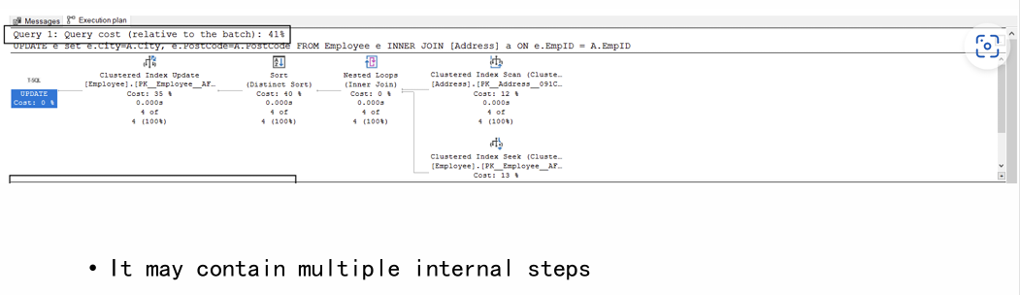
Example: Explain of a simple UPDATE

Slide 18
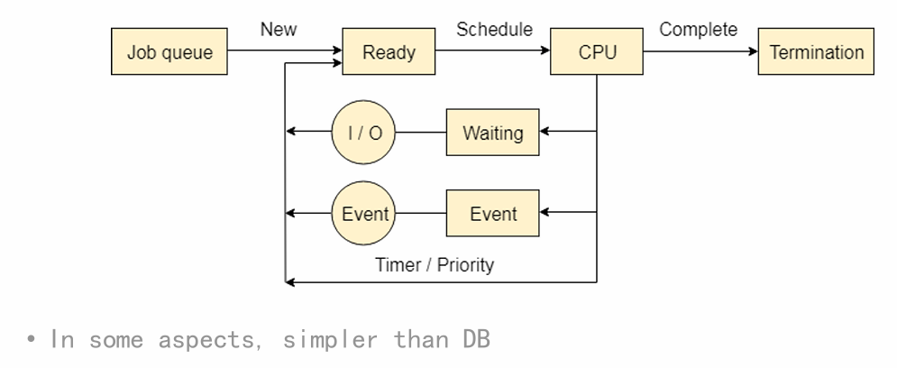
Process Scheduling in OS

Slide 19
Concurrent Executions
Multiple transactions are allowed to run concurrently in the system. Advantages are:
  Increased processor and disk utilization, leading to better transaction throughput
    E.g., one transaction can be using the CPU while another is reading from or writing to the disk
  Reduced average response time for transactions: short transactions need not wait behind long ones.
Concurrency control schemes – mechanisms to achieve isolation
  That is, to control the interaction among the concurrent transactions in order to prevent them from destroying the consistency of the database
    Will study in Chapter 15, after studying notion of correctness of concurrent executions.

Slide 20
Schedules
Schedule – a sequences of instructions that specify the chronological order in which instructions of concurrent transactions are executed
  A schedule for a set of transactions must consist of all instructions of those transactions
  Must preserve the order in which the instructions appear in each individual transaction.
A transaction that successfully completes its execution will have a commit instructions as the last statement
  By default transaction assumed to execute commit instruction as its last step
A transaction that fails to successfully complete its execution will have an abort instruction as the last statement

Slide 21

Analogy
Interweave multiple threads

Slide 22
Schedule 1
Let T₁ transfer $50 from A to B, and T₂ transfer 10% of the balance from A to B.
A serial schedule in which T₁ is followed by T₂ :

Slide 23
Schedule 2
A serial schedule where T₂ is followed by T₁

Slide 24
Schedule 3
Let T₁ and T₂ be the transactions defined previously. The following schedule is not a serial schedule, but it is equivalent to Schedule 1
In Schedules 1, 2 and 3, the sum A + B is preserved.

Slide 25
Schedule 4
The following concurrent schedule does not preserve the value of (A + B ).

Slide 26
Serializability
Basic Assumption – Each transaction preserves database consistency.
Thus, serial execution of a set of transactions preserves database consistency.
A (possibly concurrent) schedule is serializable if it is equivalent to a serial schedule. Different forms of schedule equivalence give rise to the notions of:
  1. Conflict serializability
  2. View serializability*(won’t be taught here)

Slide 27
Simplified view of transactions
We ignore operations other than read and write instructions
We assume that transactions may perform arbitrary computations on data in local buffers in between reads and writes.
Our simplified schedules consist of only read and write instructions.

Slide 28
Conflicting Instructions
Instructions l_{i} and l_{j} of transactions T_{i} and T_{j} respectively, conflict if and only if there exists some item Q accessed by both l_{i} and l_{j}, and at least one of these instructions wrote Q.
1. l_{i} = read(Q), l_{j} = read(Q). l_{i} and l_{j} don’t conflict.
2. l_{i} = read(Q), l_{j} = write(Q). They conflict.
3. l_{i} = write(Q), l_{j} = read(Q). They conflict
4. l_{i} = write(Q), l_{j} = write(Q). They conflict
Intuitively, a conflict between l_{i} and l_{j} forces a (logical) temporal order between them.
If l_{i} and l_{j} are consecutive in a schedule and they do not conflict, their results would remain the same even if they had been interchanged in the schedule.

Slide 29
Conflict Serializability
If a schedule S can be transformed into a schedule S’ by a series of swaps of non-conflicting instructions, we say that S and S’ are conflict equivalent.
We say that a schedule S is conflict serializable if it is conflict equivalent to a serial schedule

Slide 30
Conflict Serializability (Cont.)
Schedule 3 can be transformed into Schedule 6, a serial schedule where T₂ follows T₁, by series of swaps of non-conflicting instructions. Therefore Schedule 3 is conflict serializable.
Schedule 3
Schedule 6

Slide 31
Conflict Serializability (Cont.)
Example of a schedule that is not conflict serializable:
We are unable to swap instructions in the above schedule to obtain either the serial schedule < T₃, T₄ >, or the serial schedule < T₄, T₃ >.

Slide 32
Testing for Serializability
Consider some schedule of a set of transactions T₁, T₂, ..., T_{n}
Precedence graph — a direct graph where the vertices are the transactions (names).
We draw an arc from T_{i} to T_{j} if the two transaction conflict, and T_{i} accessed the data item on which the conflict arose earlier.
We may label the arc by the item that was accessed.
Example of a precedence graph

Slide 33
Test for Conflict Serializability
A schedule is conflict serializable if and only if its precedence graph is acyclic.
Cycle-detection algorithms exist which take order n² time, where n is the number of vertices in the graph.
  (Better algorithms take order n + e where e is the number of edges.)
If precedence graph is acyclic, the serializability order can be obtained by a topological sorting of the graph.
  This is a linear order consistent with the partial order of the graph.
  For example, a serializability order for Schedule A would be
  T₅ → T₁ → T₃ → T₂ → T₄
    Are there others?

Slide 34
Recoverable Schedules
Need to address the effect of transaction failures on concurrently
running transactions.
Recoverable schedule — if a transaction T_{j} reads a data item previously written by a transaction T_{i} , then the commit operation of T_{i} appears before the commit operation of T_{j}.
The following schedule (Schedule 11) is not recoverable
If T₈ should abort, T₉ would have read (and possibly shown to the user) an inconsistent database state. Hence, database must ensure that schedules are recoverable.

Slide 35
Cascading Rollbacks
Cascading rollback – a single transaction failure leads to a series of transaction rollbacks. Consider the following schedule where none of the transactions has yet committed (so the schedule is recoverable)
If T₁₀ fails, T₁₁ and T₁₂ must also be rolled back.
Can lead to the undoing of a significant amount of work

Slide 36
Cascadeless Schedules
Cascadeless schedules — cascading rollbacks cannot occur;
  For each pair of transactions T_{i} and T_{j} such that T_{j} reads a data item previously written by T_{i}, the commit operation of T_{i} appears before the read operation of T_{j}.
Every Cascadeless schedule is also recoverable
It is desirable to restrict the schedules to those that are cascadeless

Slide 37
Concurrency Control
A database must provide a mechanism that will ensure that all possible schedules are
  either conflict or view serializable, and
  are recoverable and preferably cascadeless
A policy in which only one transaction can execute at a time generates serial schedules, but provides a poor degree of concurrency
  Are serial schedules recoverable/cascadeless?
Testing a schedule for serializability after it has executed is a little too late!
Goal – to develop concurrency control protocols that will assure serializability.

Slide 38
Concurrency Control (Cont.)
Schedules must be conflict serializable, and recoverable, for the sake of database consistency, and preferably cascadeless.
A policy in which only one transaction can execute at a time generates serial schedules, but provides a poor degree of concurrency.
Concurrency-control schemes tradeoff between the amount of concurrency they allow and the amount of overhead that they incur.
Some schemes allow only conflict-serializable schedules to be generated, while others allow view-serializable schedules that are not conflict-serializable.

Slide 39
Concurrency Control vs. Serializability Tests
Concurrency-control protocols allow concurrent schedules, but ensure that the schedules are conflict/view serializable, and are recoverable and cascadeless .
Concurrency control protocols (generally) do not examine the precedence graph as it is being created
  Instead a protocol imposes a discipline that avoids non-serializable schedules.
  We study such protocols in Chapter 16.
Different concurrency control protocols provide different tradeoffs between the amount of concurrency they allow and the amount of overhead that they incur.
Tests for serializability help us understand why a concurrency control protocol is correct.

Slide 40
Question
What is the relationship between Recoverable Schedules and Collision Serializability?
  Independent but need to coexist
Property | The "Evil" it Prevents | Core Focus
Conflict Serializability | Incorrect Final Outcome | Even if all transactions commit successfully, the final database state could be wrong.
Recoverability | Unrecoverability after Commit | The failure of one transaction can cause already-committed transactions to be based on invalid data.

Slide 41
Question
A schedule can be Conflict-Serializable but NOT Recoverable.
Analysis:
  Conflict-Serializable? Yes. This schedule is conflict-equivalent to the serial schedule <T1, T2>. If the system runs normally, the final state is correct.
  Recoverable? No! If the system crashes after T2 commits but before T1 commits, T1 must be rolled back. However, T2 has already committed, and it read a value of A from T1 (a value that subsequently vanished with T1's rollback). This results in a committed transaction (T2) being based on a state that never officially existed, permanently corrupting the database's consistency.
T1 T2 --- --- write(A) read(A) // T2 read A written by T1 commit // **Danger! T2 commits before T1** commit

Slide 42
Question
A schedule can be Recoverable but NOT Conflict-Serializable.
Analysis:
  Conflict-Serializable? No. The precedence graph has a cycle (T1 -> T2 -> T1), so it is not equivalent to any serial schedule. The final outcome might be incorrect.
  Recoverable? Yes. Although the result might be wrong, from a recovery perspective, this schedule does not violate the commit-order rule for read-after-write dependencies. Here, T2 writes A, but T1 did not read the A written by T2 (it read the initial A). Thus, there is no "read-dependency" to enforce. Therefore, the abort of either transaction would not cause the other committed transaction to have read its dirty data.
T1 T2
--- ---
read(A)
write(A)
write(A)
commit
commit

Slide 43
Weak Levels of Consistency
Some applications are willing to live with weak levels of consistency, allowing schedules that are not serializable
  E.g., a read-only transaction that wants to get an approximate total balance of all accounts
  E.g., database statistics computed for query optimization can be approximate (why?)
  Such transactions need not be serializable with respect to other transactions
Tradeoff accuracy for performance

Slide 44
Levels of Consistency in SQL-92
Serializable — default
Repeatable read — only committed records to be read.
  Repeated reads of same record must return same value.
  However, a transaction may not be serializable – it may find some records inserted by a transaction but not find others.
Read committed — only committed records can be read.
  Successive reads of record may return different (but committed) values.
Read uncommitted — even uncommitted records may be read.

Slide 45
Levels of Consistency
Lower degrees of consistency useful for gathering approximate
information about the database
Warning: some database systems do not ensure serializable schedules by default
E.g., Oracle (and PostgreSQL prior to version 9) by default support a level of consistency called snapshot isolation (not part of the SQL standard)

Slide 46
Question
If it's not Serializable, does that break conflict serializability?
  If the isolation level is set to a level lower than Serializable (such as Repeatable Read, Read Committed, or Read Uncommitted), then the system allows for non-conflicting serializable scheduling, thus "breaking" conflict-serializable.

Slide 47
Transaction Definition in SQL
In SQL, a transaction begins implicitly.
A transaction in SQL ends by:
  Commit work commits current transaction and begins a new one.
  Rollback work causes current transaction to abort.
In almost all database systems, by default, every SQL statement also commits implicitly if it executes successfully
  Implicit commit can be turned off by a database directive
    E.g., in JDBC -- connection.setAutoCommit(false);
Isolation level can be set at database level
Isolation level can be changed at start of transaction
    E.g. In SQL set transaction isolation level serializable
    E.g. in JDBC -- connection.setTransactionIsolation(
    Connection.TRANSACTION_SERIALIZABLE)

Slide 48
Implementation of Isolation Levels
Locking
  Lock on whole database vs lock on items
  How long to hold lock?
  Shared vs exclusive locks
Timestamps
  Transaction timestamp assigned e.g. when a transaction begins
  Data items store two timestamps
    Read timestamp
    Write timestamp
  Timestamps are used to detect out of order accesses
Multiple versions of each data item
  Allow transactions to read from a “snapshot” of the database

Slide 49
Transactions as SQL Statements
E.g., Transaction 1:
select ID, name from instructor where salary > 90000
E.g., Transaction 2:
insert into instructor values ('11111', 'James', 'Marketing', 100000)
Suppose
  T1 starts, finds tuples salary > 90000 using index and locks them
  And then T2 executes.
  Do T1 and T2 conflict? Does tuple level locking detect the conflict?
  Instance of the phantom phenomenon
Also consider T3 below, with Wu’s salary = 90000
update instructor
set salary = salary * 1.1
where name = 'Wu’
Key idea: Detect “predicate” conflicts, and use some form of “predicate locking”

Slide 50

Reading&Demo
https://www.thenile.dev/blog/transaction-isolation-postgres
1-3

